Slide 1

Main Memory
Instructor Name: Ms. Laraib Razzaq
Department of Computer Science, IQRA University Islamabad – H9 Campus - Pakistan

Slide 2
Memory Management
Contiguous Memory Allocation
Segmentation
Paging
Structure of the Page Table

Slide 3
Contiguous Allocation
Main memory must support both OS and user processes
Limited resource, must allocate efficiently
Contiguous allocation is one early method
Main memory usually into two partitions:
Resident operating system, usually held in low memory with interrupt vector
User processes then held in high memory
Each process contained in single contiguous section of memory

Slide 4
Contiguous Allocation (Cont.)
Relocation registers used to protect user processes from each other, and from changing operating-system code and data
Base register contains value of smallest physical address
Limit register contains range of logical addresses – each logical address must be less than the limit register
MMU maps logical address dynamically
Can then allow actions such as kernel code being transient and kernel changing size

Slide 5
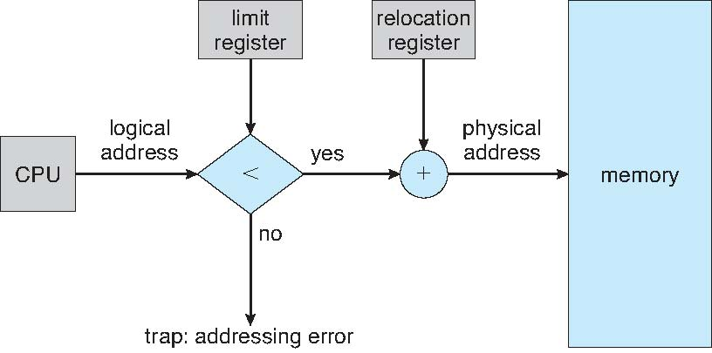
Hardware Support for Relocation and Limit Registers

Slide 6
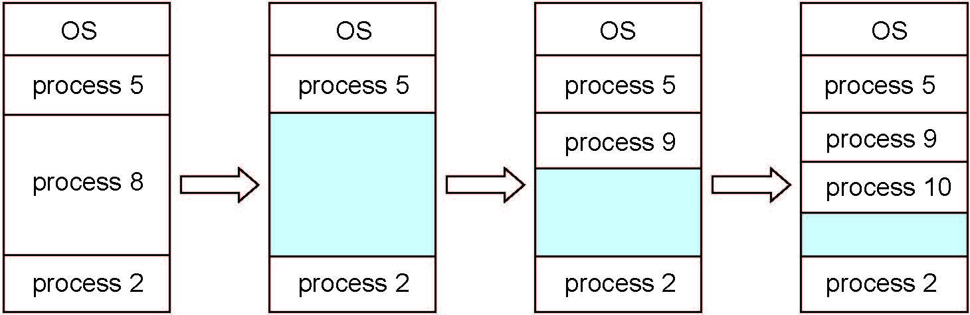
Multiple-partition allocation
Multiple-partition allocation
Degree of multiprogramming limited by number of partitions
Variable-partition sizes for efficiency (sized to a given process’ needs)
Hole – block of available memory; holes of various size are scattered throughout memory
When a process arrives, it is allocated memory from a hole large enough to accommodate it
Process exiting frees its partition, adjacent free partitions combined
Operating system maintains information about: a) allocated partitions b) free partitions (hole)

Slide 7
Dynamic Storage-Allocation Problem
How to satisfy a request of size n from a list of free holes?
First-fit: Allocate the first hole that is big enough
Best-fit: Allocate the smallest hole that is big enough; must search entire list, unless ordered by size
Produces the smallest leftover hole
Worst-fit: Allocate the largest hole; must also search entire list
Produces the largest leftover hole
First-fit and best-fit better than worst-fit in terms of speed and storage utilization

Slide 8
Fragmentation
External Fragmentation – total memory space exists to satisfy a request, but it is not contiguous
Internal Fragmentation – allocated memory may be slightly larger than requested memory; this size difference is memory internal to a partition, but not being used
First fit analysis reveals that given N blocks allocated, 0.5 N blocks lost to fragmentation
1/3 may be unusable -> 50-percent rule

Slide 9
Fragmentation (Cont.)
Reduce external fragmentation by compaction
Shuffle memory contents to place all free memory together in one large block
Compaction is possible only if relocation is dynamic, and is done at execution time
Now consider that backing store has same fragmentation problems

Slide 10
Segmentation
Memory-management scheme that supports user view of memory
A program is a collection of segments
A segment is a logical unit such as:
main program
procedure
function
method
object
local variables, global variables
common block
stack
symbol table
arrays

Slide 11
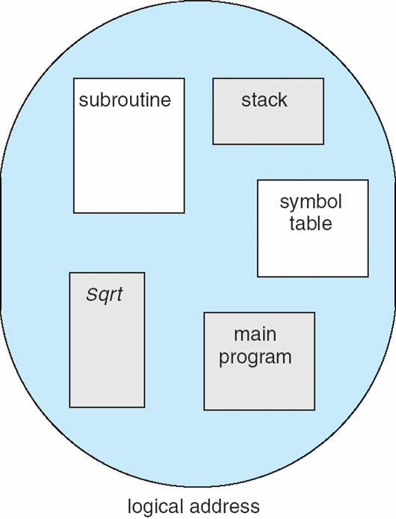
User’s View of a Program

Slide 12
Logical View of Segmentation
1
1
4
2
3
4
2
3
user space
physical memory space

Slide 13
Segmentation Architecture
Logical address consists of a two tuple:
<segment-number, offset>,
Segment table – maps two-dimensional physical addresses; each table entry has:
base – contains the starting physical address where the segments reside in memory
limit – specifies the length of the segment
Segment-table base register (STBR) points to the segment table’s location in memory
Segment-table length register (STLR) indicates number of segments used by a program;
segment number s is legal if s < STLR

Slide 14
Segmentation Architecture (Cont.)
Protection
With each entry in segment table associate:
validation bit = 0 ⇒ illegal segment
read/write/execute privileges
Protection bits associated with segments; code sharing occurs at segment level
Since segments vary in length, memory allocation is a dynamic storage-allocation problem
A segmentation example is shown in the following diagram

Slide 15
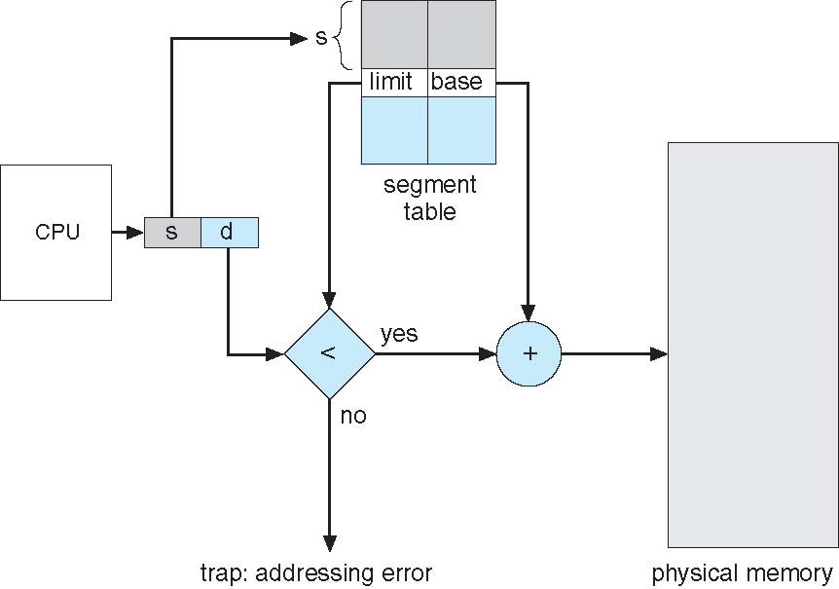
Segmentation Hardware

Slide 16
Paging
Physical address space of a process can be noncontiguous; process is allocated physical memory whenever the latter is available
Avoids external fragmentation
Avoids problem of varying sized memory chunks
Divide physical memory into fixed-sized blocks called frames
Size is power of 2, between 512 bytes and 16 Mbytes
Divide logical memory into blocks of same size called pages
Keep track of all free frames
To run a program of size N pages, need to find N free frames and load program
Set up a page table to translate logical to physical addresses
Backing store likewise split into pages
Still have Internal fragmentation

Slide 17
Address Translation Scheme
Address generated by CPU is divided into:
Page number (p) – used as an index into a page table which contains base address of each page in physical memory
Page offset (d) – combined with base address to define the physical memory address that is sent to the memory unit
For given logical address space 2^{m} and page size 2^{n}

Slide 18
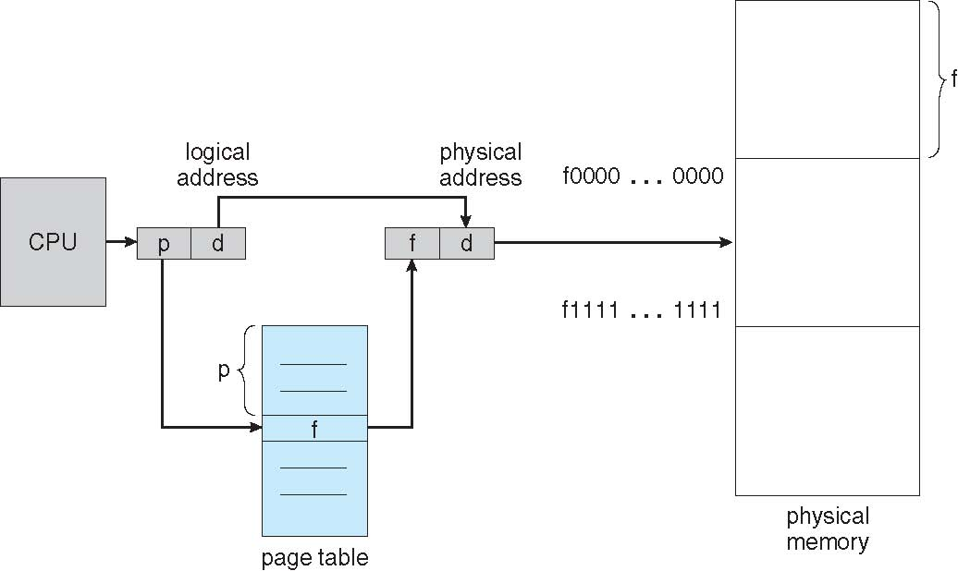
Paging Hardware

Slide 19
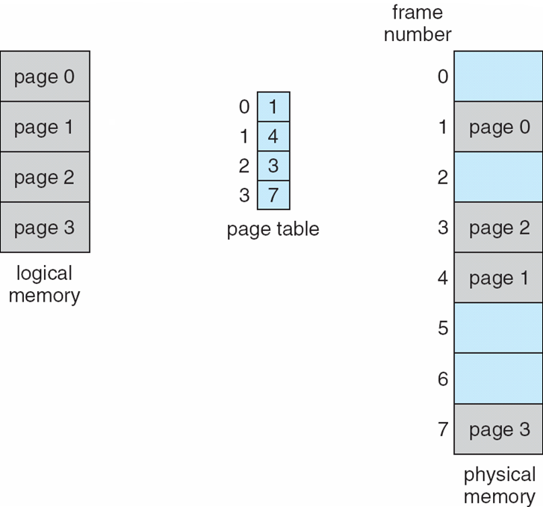
Paging Model of Logical and Physical Memory

Slide 20
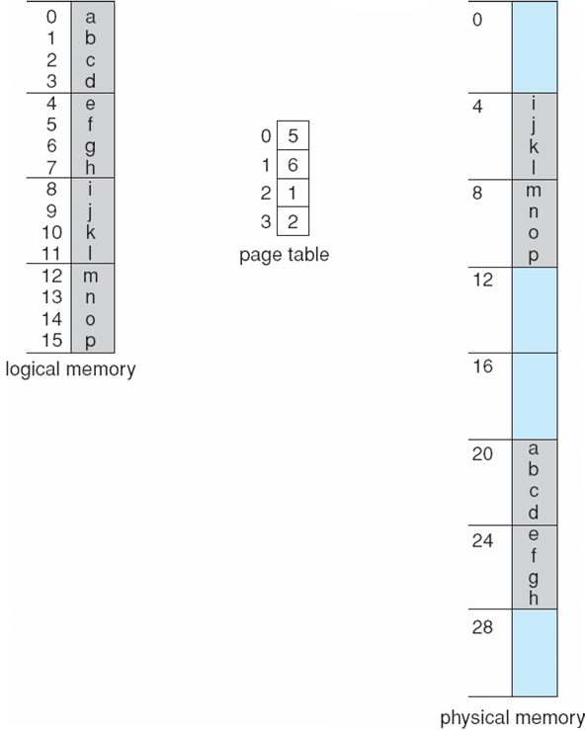
Paging Example
n=2 and m=4 32-byte memory and 4-byte pages

Slide 21
Paging (Cont.)
Calculating internal fragmentation
Page size = 2,048 bytes
Process size = 72,766 bytes
35 pages + 1,086 bytes
Internal fragmentation of 2,048 - 1,086 = 962 bytes
Worst case fragmentation = 1 frame – 1 byte
On average fragmentation = 1 / 2 frame size
So small frame sizes desirable?
But each page table entry takes memory to track
Page sizes growing over time
Solaris supports two page sizes – 8 KB and 4 MB
Process view and physical memory now very different
By implementation process can only access its own memory

Slide 22
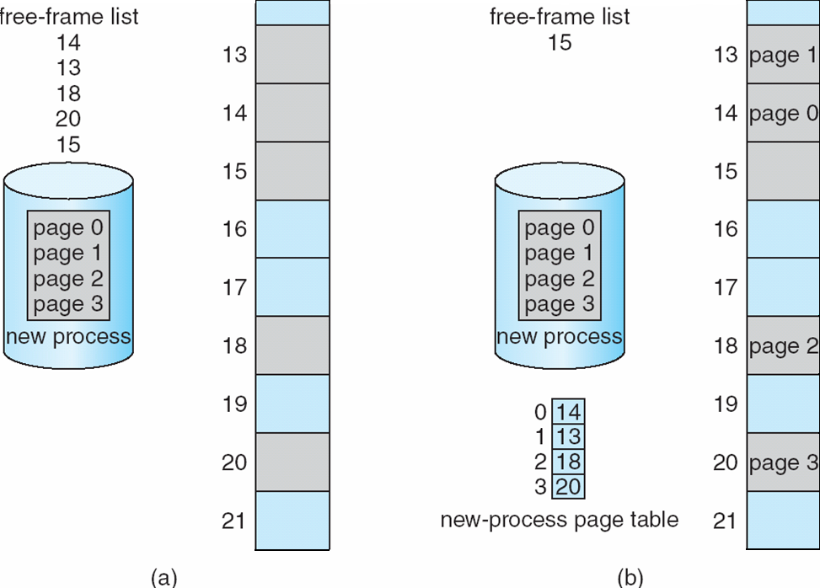
Free Frames
Before allocation
After allocation

Slide 23
Implementation of Page Table
Page table is kept in main memory
Page-table base register (PTBR) points to the page table
Page-table length register (PTLR) indicates size of the page table
In this scheme every data/instruction access requires two memory accesses
One for the page table and one for the data / instruction
The two memory access problem can be solved by the use of a special fast-lookup hardware cache called associative memory or translation look-aside buffers (TLBs)

Slide 24
Implementation of Page Table (Cont.)
Some TLBs store address-space identifiers (ASIDs) in each TLB entry – uniquely identifies each process to provide address-space protection for that process
Otherwise need to flush at every context switch
TLBs typically small (64 to 1,024 entries)
On a TLB miss, value is loaded into the TLB for faster access next time
Replacement policies must be considered
Some entries can be wired down for permanent fast access

Slide 25
Associative Memory
Associative memory – parallel search
Address translation (p, d)
If p is in associative register, get frame # out
Otherwise get frame # from page table in memory

Slide 26
Memory Protection
Memory protection implemented by associating protection bit with each frame to indicate if read-only or read-write access is allowed
Can also add more bits to indicate page execute-only, and so on
Valid-invalid bit attached to each entry in the page table:
“valid” indicates that the associated page is in the process’ logical address space, and is thus a legal page
“invalid” indicates that the page is not in the process’ logical address space
Or use page-table length register (PTLR)
Any violations result in a trap to the kernel

Slide 27
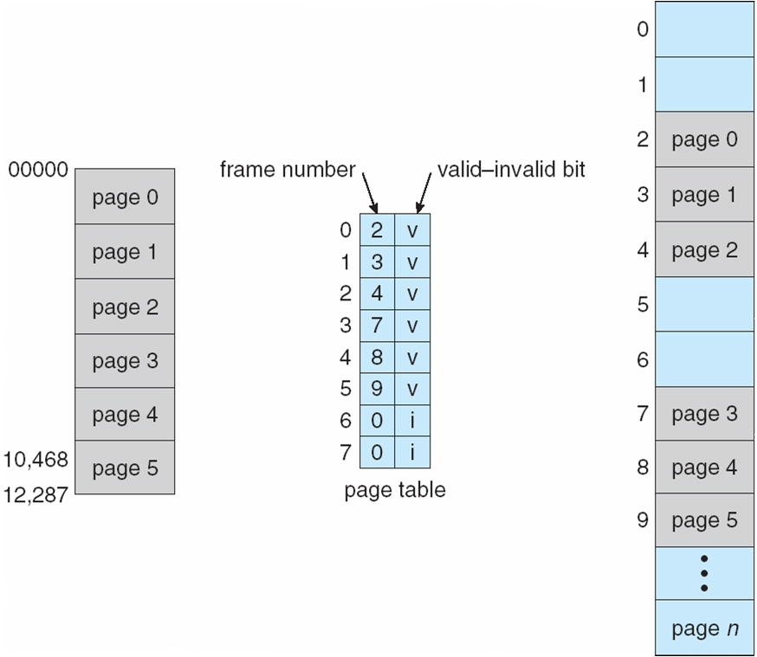
Valid (v) or Invalid (i) Bit In A Page Table

Slide 28
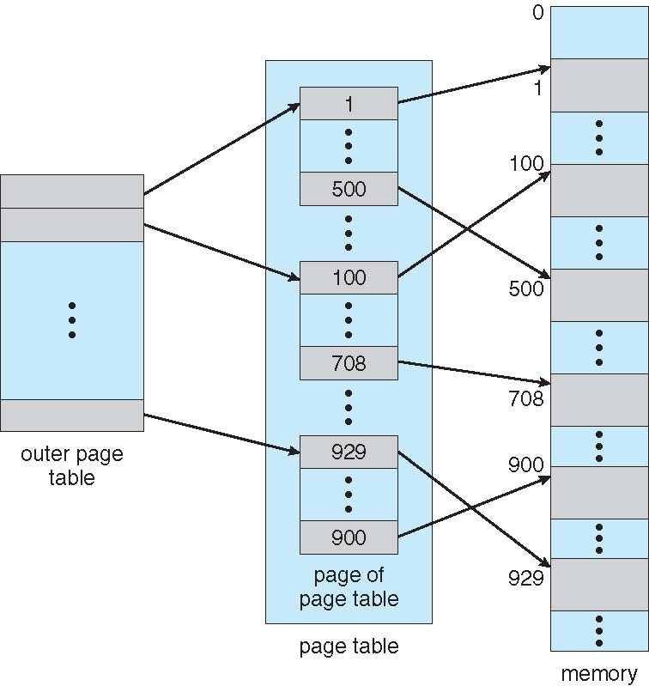
Two-Level Page-Table Scheme

Slide 29
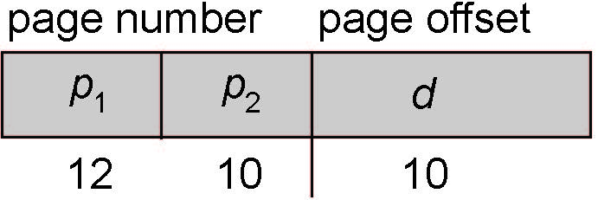
Two-Level Paging Example
A logical address (on 32-bit machine with 1K page size) is divided into:
a page number consisting of 22 bits
a page offset consisting of 10 bits
Since the page table is paged, the page number is further divided into:
a 12-bit page number
a 10-bit page offset
Thus, a logical address is as follows:
where p₁ is an index into the outer page table, and p₂ is the displacement within the page of the inner page table
Known as forward-mapped page table

Slide 30
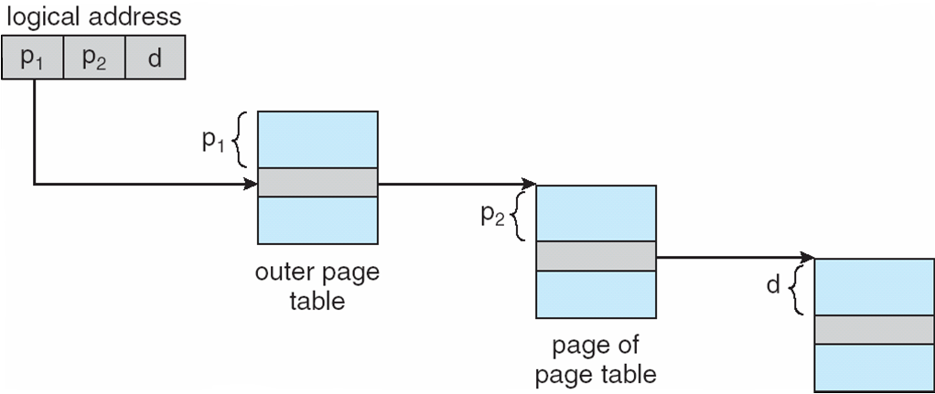
Address-Translation Scheme

Slide 31
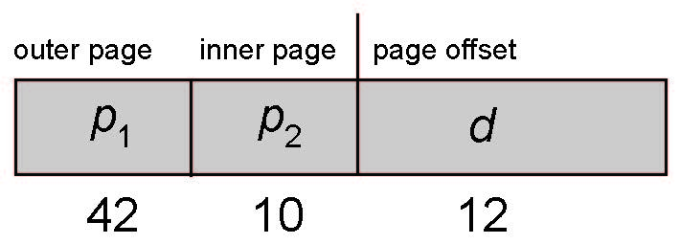
64-bit Logical Address Space
Even two-level paging scheme not sufficient
If page size is 4 KB (2¹²)
Then page table has 2⁵² entries
If two level scheme, inner page tables could be 2¹⁰ 4-byte entries
Address would look like
Outer page table has 2⁴² entries or 2⁴⁴ bytes
One solution is to add a 2nd outer page table
But in the following example the 2nd outer page table is still 2³⁴ bytes in size
And possibly 4 memory access to get to one physical memory location

Slide 32
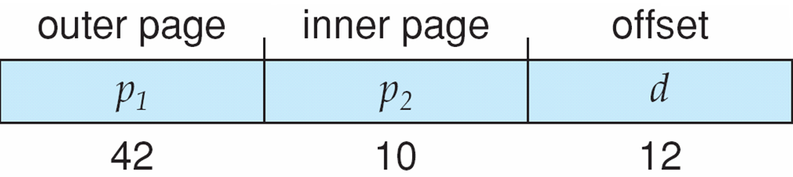
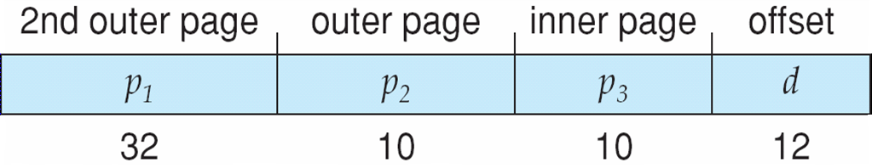
Three-level Paging Scheme

Slide 33
Hashed Page Tables
Common in address spaces > 32 bits
The virtual page number is hashed into a page table
This page table contains a chain of elements hashing to the same location
Each element contains (1) the virtual page number (2) the value of the mapped page frame (3) a pointer to the next element
Virtual page numbers are compared in this chain searching for a match
If a match is found, the corresponding physical frame is extracted
Variation for 64-bit addresses is clustered page tables
Similar to hashed but each entry refers to several pages (such as 16) rather than 1
Especially useful for sparse address spaces (where memory references are non-contiguous and scattered)

Slide 34
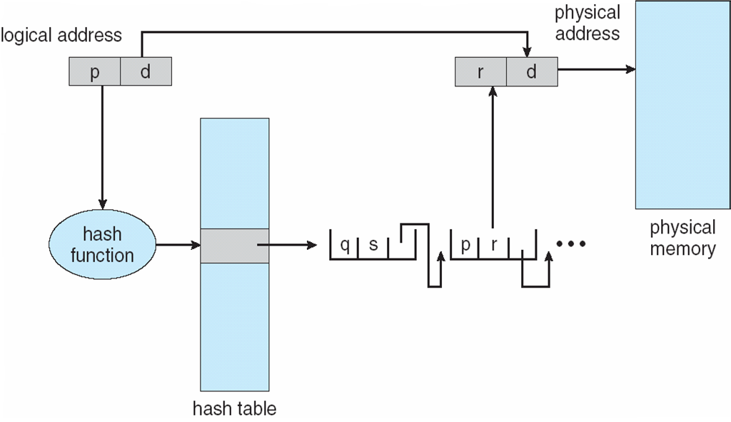
Hashed Page Table

Slide 35
Inverted Page Table
Rather than each process having a page table and keeping track of all possible logical pages, track all physical pages
One entry for each real page of memory
Entry consists of the virtual address of the page stored in that real memory location, with information about the process that owns that page
Decreases memory needed to store each page table, but increases time needed to search the table when a page reference occurs
Use hash table to limit the search to one — or at most a few — page-table entries
TLB can accelerate access
But how to implement shared memory?
One mapping of a virtual address to the shared physical address

Slide 36
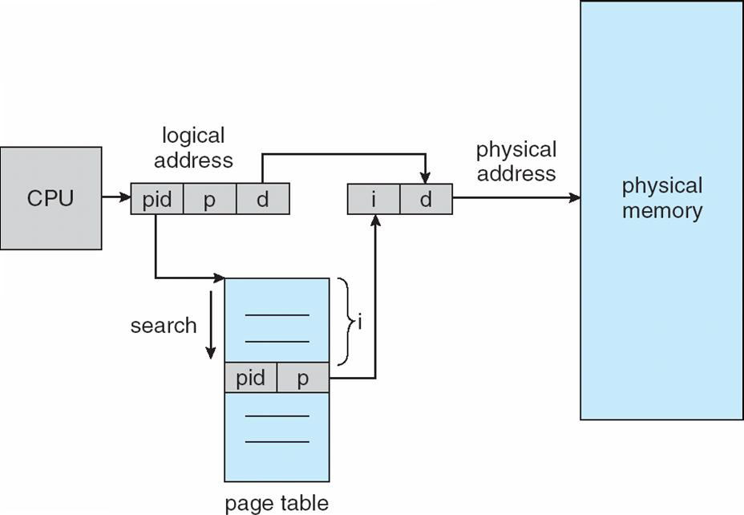
Inverted Page Table Architecture

Slide 37
Thank You

